Slide 1

KRUSHISAT
POWER SYSTEM DESIGN FOR A PICO SATELLITE
BY:
GUIDED BY: D.AKHIL KRISHNA(15J41A0212)
EZHIL VIGNESH K.BHAVANI(15J41A0226)
ASSOCIATE PROFESSOR N. MAMATHA(15J41A0239)
EEE DEPARTMENT DEP:ELECTRICAL AND ELECTRONICS
MALLA REDDY ENGINEERING COLLEGE(A)

Slide 2
CONTENT
Introduction
Block Diagram
Subsystems
Power System Unit
Communication System
Payloads
Antenna Deployment
Simulation Software and Details
Simulation Results
Conclusion
References

Slide 3
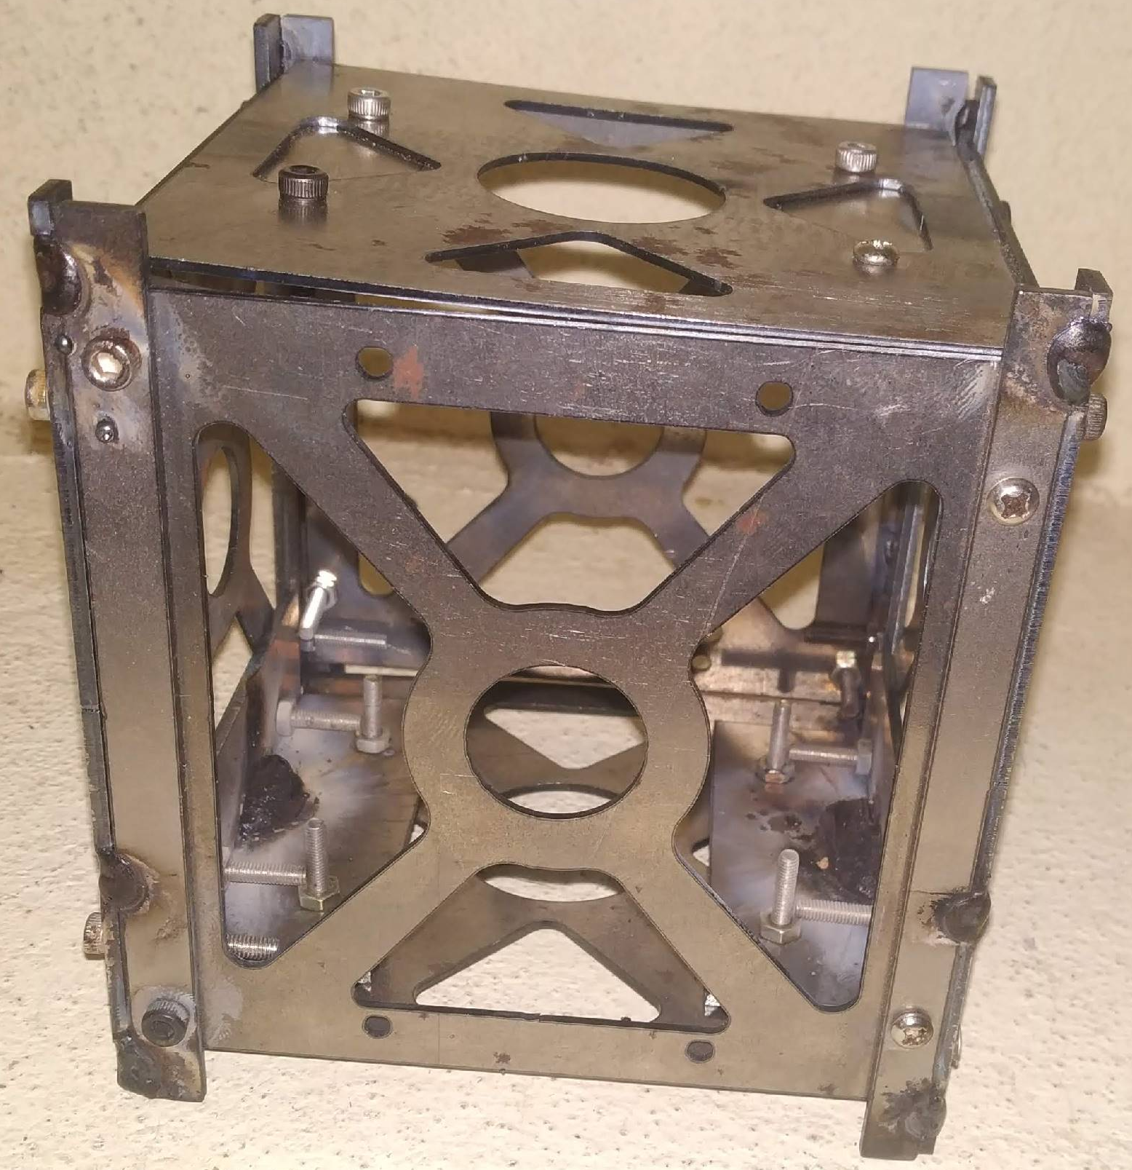
INTRODUCTION
A Low Cost Pico Satellite.
It is involved in design, development and fabrication of a Pico-Satellite named “KRUSHISAT”
It elaborates upon different Subsystems.
Dimensions: (10*10*10) cm
Mass: Less than or equal to 1KG
Materials used: Aluminium, Steel, Plastic.

Slide 4
PAYLOADS
Transmitting Point to point messaging.
Determining Losses and other factors
Monitoring Atmospheric Conditions Temperature , Humidity of the Low Earth Orbit.
Flux Density of the Low Earth Orbit.

Slide 5
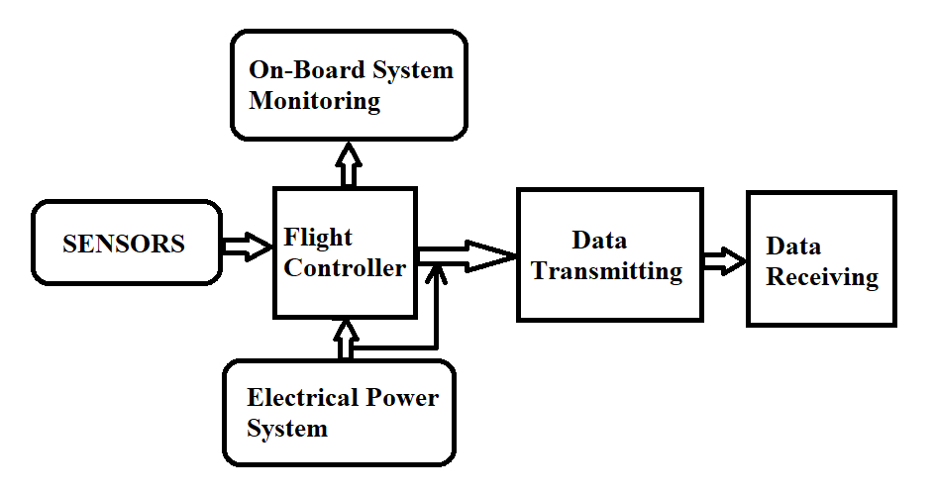
BLOCK DIAGRAM

Slide 6
SUBSYSTEMS
There are FIVE Subsystems. They are:
Structure
Power System
Payloads
Antenna Deployment
Attitude Control System

Slide 7
POWER SYSTEM UNIT
Purpose of power system is to supply the power to On-board System of the Satellite and to the Antenna.
Power System Consists of:
Solar Cells
Converter Circuits
Battery Pack
Battery Protection Circuit

Slide 8
PSU BLOCK DIAGRAM
SOLAR PANELS
DIODE
BATTERY PROTECTION CIRCUIT
BATTERY PACK
BOOST CONVERTER
OTHER SUBSYSTEM
BOOST CONVERTER
ON-BOARD SYSTEM
BUCK CONVETER

Slide 9
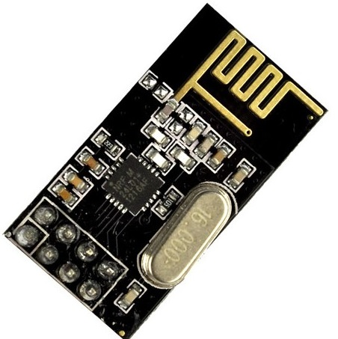
COMMUNICATION SYSTEM
In order to create communication between the satellite and ground station i.e., receiver a communication system is used.
Communication is in the form of Signals.
Main part of communication system is NRF24L01
Trans-receiver module used for two way communication.
Communication system provides the health
conditions of satellite time to time.

Slide 10
COMMUNICATION BLOCK DIAGRAM
TRANSMITTER RECEIVER
Arduino UNO/NANO Boards
Arduino UNO/NANO Boards
Sensors
RF Transceiver Module
TRANSMITTING
RF Transceiver Module

Slide 11
ANTENNA DEPLOYEMENT
Antennas are critical components in the onboard communication system of satellites
The easiest way of implementing a heating element to burn the Dyneema is using a high resistance wire preferably Nichrome because of its wide availability and simple set up.

Slide 12
SIMULATION SOFTWARE AND DETAILS AND RESULTS
SYSTEM TOOL KIT
FOUR DIMENSIONAL .
REAL TIME ENVIRONMENT.
ANALYSIS OF AIRCRAFTS , MISSILES, AND SATELLITE OBJECTS.

Slide 13
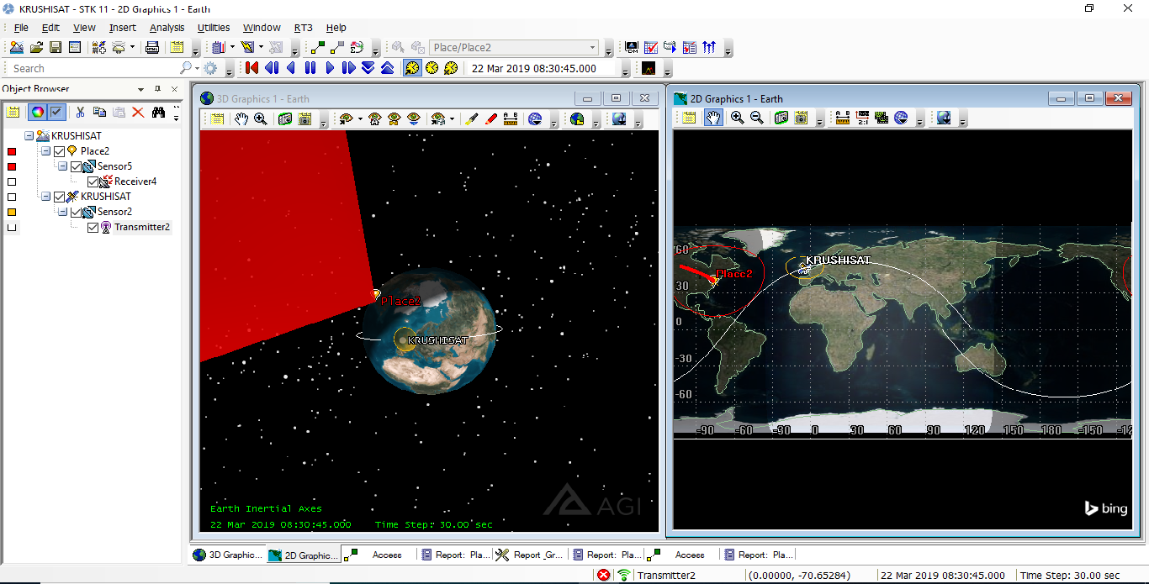

Slide 14
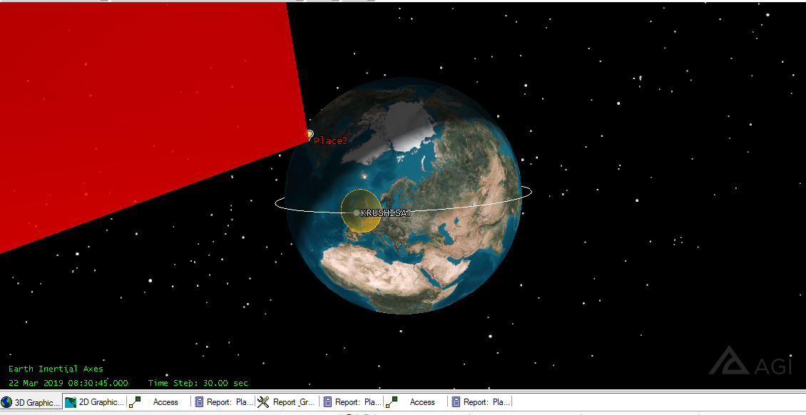

Slide 15
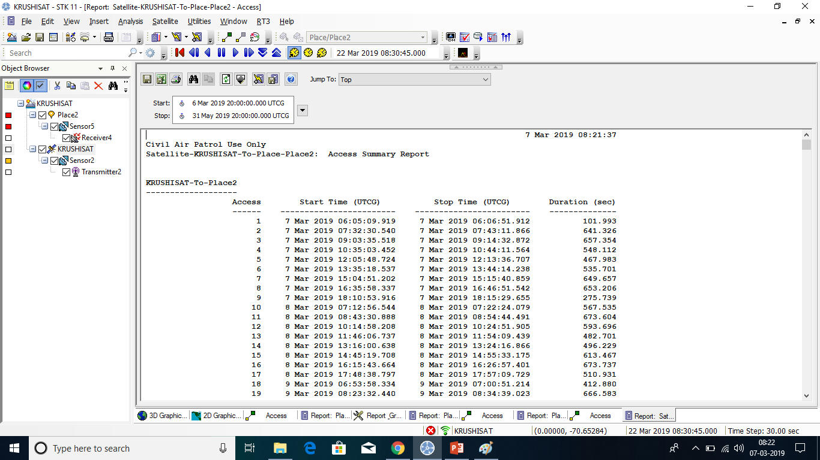

Slide 16
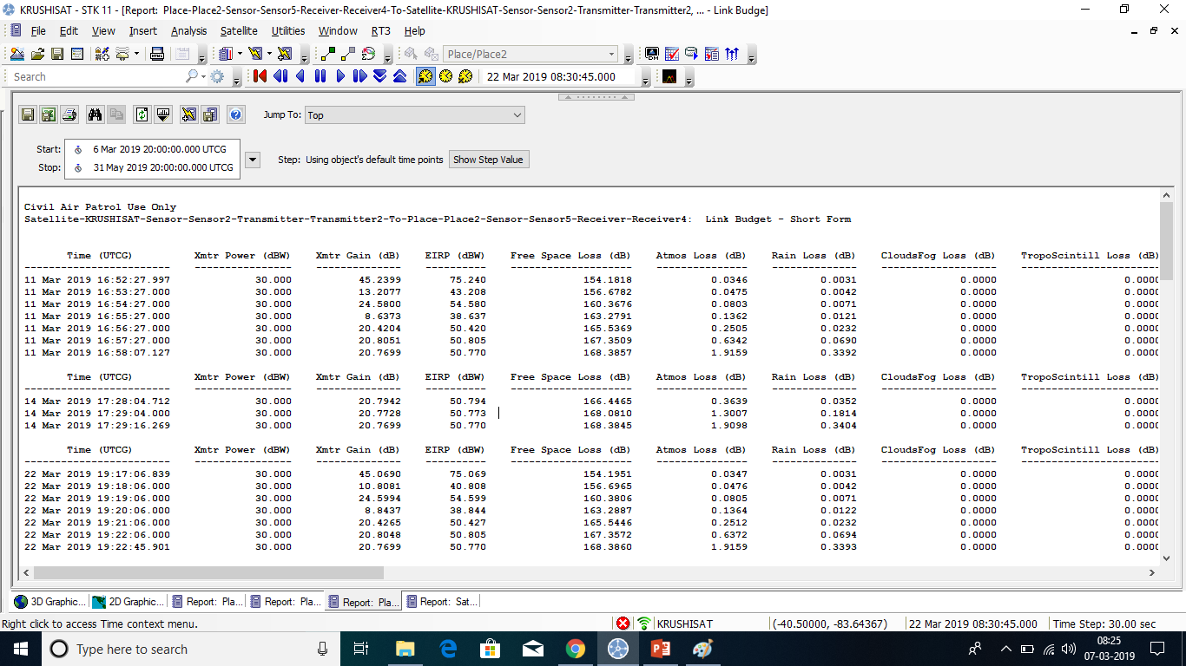

Slide 17
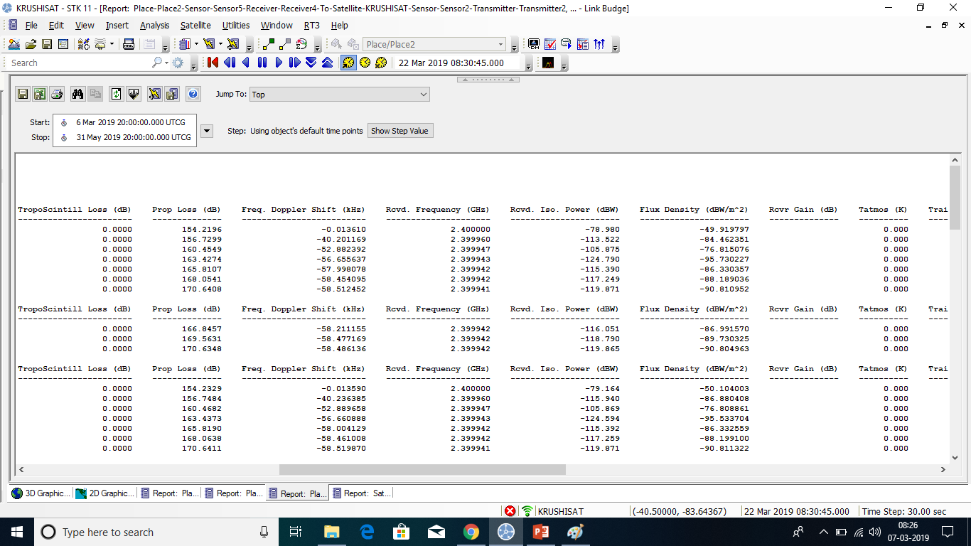

Slide 18
CONCLUSION
This project is aiming towards promoting space technology in educational institutions and enabling students and faculty to gain knowledge in the field of satellites.
To Gain hands-on experience with the design fabrication and realization of a space mission at a minimum cost.

Slide 19
REFERENCES
STUDSAT: India’s First Student Pico-Satellite Project-978-1-4244-7351-9/11/©2011 IEEE 2
IEEEAC paper#1069, Version 2, Updated 2011:01:14
Antennas for Modern Small Satellites- IEEE AntennasandPropagation Magazine, Vol. 51, No.4, August 2009
Power Supply Design for Sathyabama University Nano Satellite-978-1-4244-9182-7/10/©2010 IEEE
Low cost S band communication system for Nano satellites- 978-1-4244-9616-7/11/©2011 IEEE
On Board Communication Subsystem for Sathyabama University Nano-Satellite-978-1-4244-9182-7/10/©2010 IEEE
Novel Low Cost Standardized Nano-Satellite Structure Bus for LEO Missions-978-1-4673-1813-6/13/©2013 IEEE
Design and Optimization of the On Board DC/DC Converters of Swayam Satellite-2014 IEEE International Conference on Power2014
Development of Antenna Deployment Circuit for Nano-Satellites-Pramath Keny, Arya Menon, Madhura Rao, Urvang Gaitonde, Animesh Gupta, Annamaneni Sriharsha,Manipal Institute of Technology.

Slide 20
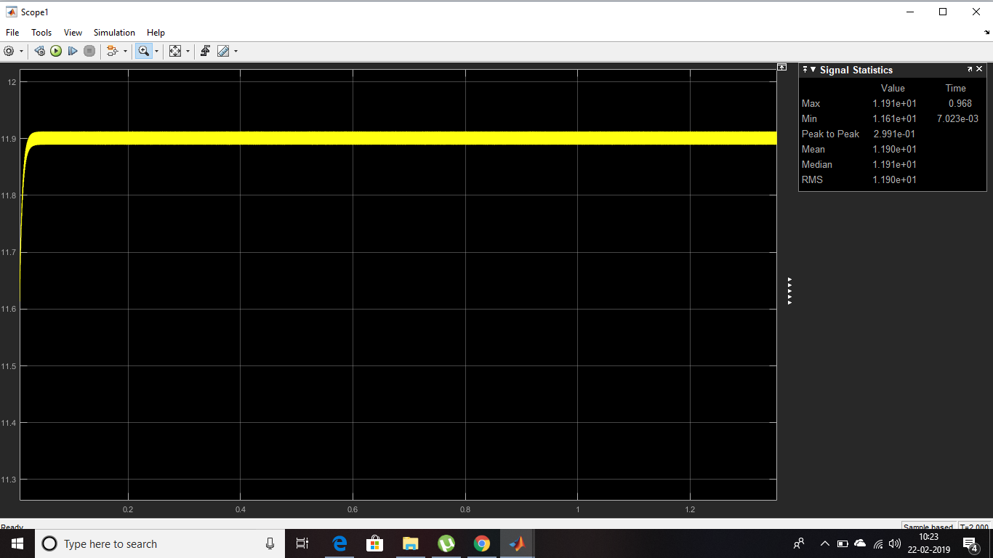

Slide 21
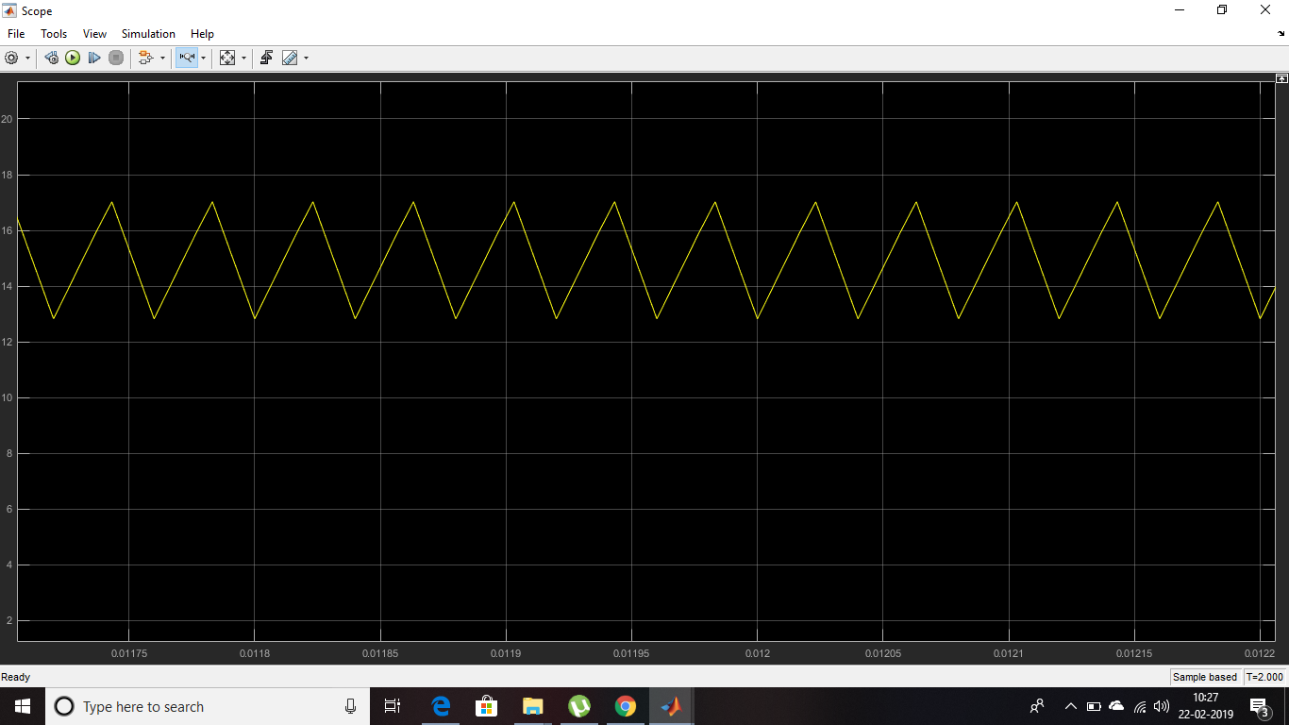

Slide 22
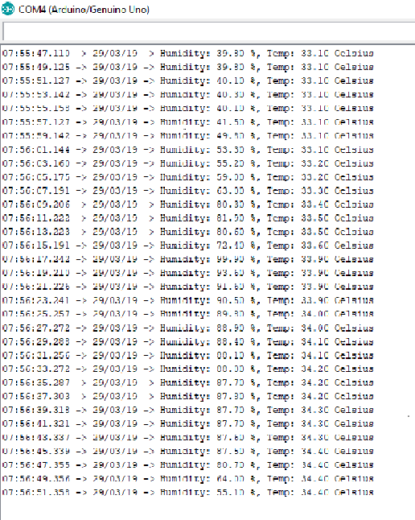

Slide 23
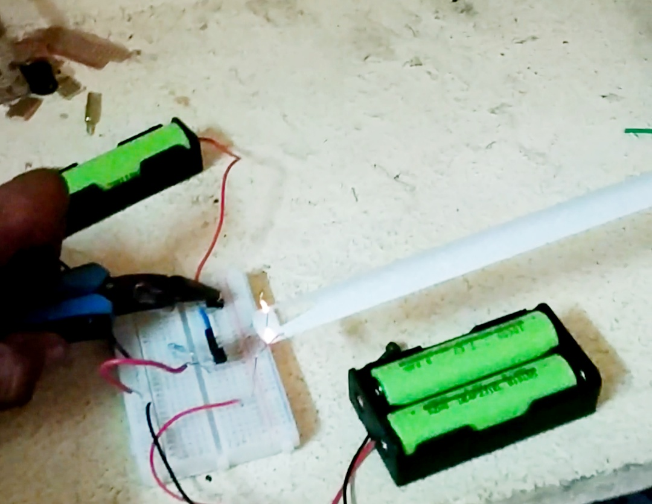

Slide 24
THANK YOU……..!!!!
????
QUERIESAREAPPRECIABLE..!!

